Slide 1
Using SMOTE in predicting MBTI personality type based on online posts
05/25/2021 Final Project Presentation
CORONIA | LEYESA | LOPEZ

Slide 2
Background on MBTIs
Assigns personality type to the participant based on four “dichotomies”:
Extraversion / Introversion
Sensing / Intuition
Thinking / Feeling
Judging / Perceiving
Type indicators (or the letters) typically put together to form one’s MBTI type (e.g. ESTJ, INFP)

Slide 3
Problem Statement
We explore MBTI type prediction as a multi-class text classification problem (i.e., the 16 MBTIs).
We attempt to address class imbalance in the dataset via SMOTE, a data augmentation technique where we generate synthetic data for minority classes.

Slide 4
Our Data
Contains two (2) columns and 8.6k rows of data.
type: A person’s 4-letter MBTI personality type.
posts: Contains 50 of the person’s most recent posts, separated by “|||”
Posts are raw text -- unprocessed.
Posts truncated at around 200 characters each.
No null/empty rows.
Unbalanced dataset.
Contains emoji in the form :keyword: (Markdown style)
Users quote other users in the form [QUOTE=username;id]

Slide 5
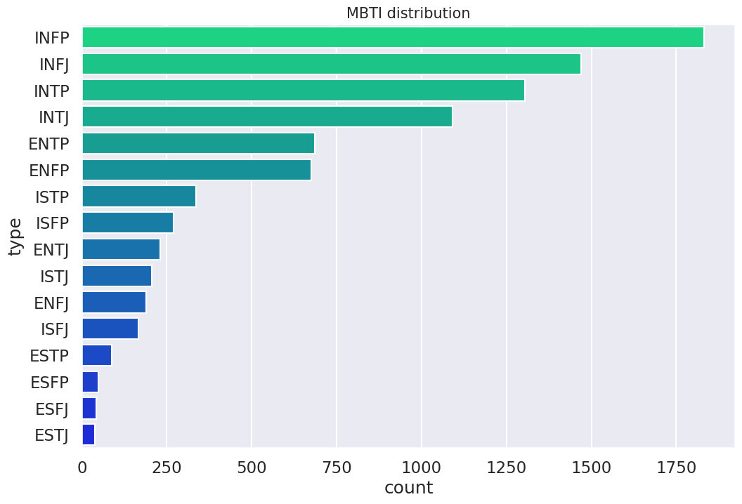
Problem Statement: Class Imbalance

Slide 6
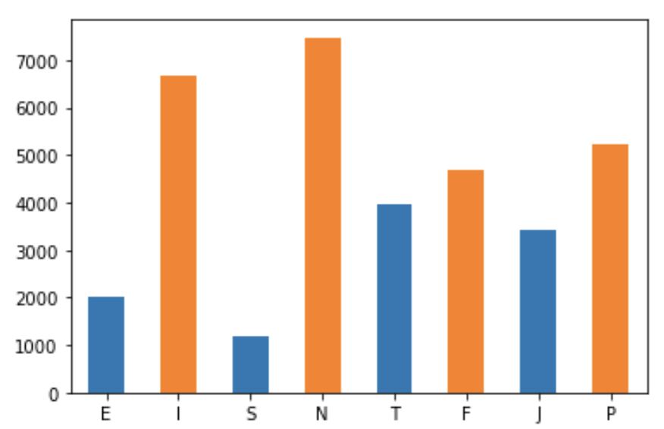
Problem Statement: Class Imbalance
I/E - Introvert-Extrovert
N/S - Intuition-Sensing
T/F - Thinking-Feeling
J/P - Judging-Perception

Slide 7
Objectives
Build and compare models between for all 16 classes.
Explore the effect of Synthetic Minority Over-Sampling Technique, or SMOTE, as a data augmentation technique for classification.
60% training set with SMOTE.
40% test set.
Notes:
We perform here a stratified train-test split. This ensures that all 16 classes are represented in both training and test sets.

Slide 8
METHODOLOGY: Data Preprocessing
Remove web links or URLs.
Non-words (or other special characters) are removed.
Text is casted into lowercase.
Mentions of MBTI classes are removed in the text.
Stop words are removed.
Tokenization and Lemmatization.
Notes:
Lemmatization so that similar words with different affixes (memory and memories) are turned both to “memory”.
We don’t perform stemming as opposed to lemmatization to ensure that the resulting output (or lemma) is a language word.

Slide 9
METHODOLOGY
We use Term Frequency (TF) and Inverse Document Frequency (IDF) for feature extraction.
10% - 70% of occurrences are considered.
We use the following models:
Logistic Regression (LOG)
XG Boost (XGB)
Support Vector Machine (SVM)
Multinomial Naive Bayes (MNB)

Slide 10
Results and Discussion: Table of Accuracies
Classifier Model | Non-SMOTE | SMOTE
XGB | 25.64% | 23.98%
LOG | 27.51% | 19.80%
SVM | 26.92% | 27.57%
MNB | 25.11% | 21.11%

Slide 11
Results and Discussion: Table of F-Scores
Classifier Model | Non-SMOTE | SMOTE
XGB | 0.20 | 0.20
LOG | 0.23 | 0.22
SVM | 0.21 | 0.23
MNB | 0.16 | 0.23

Slide 12
Discussion of Results
Applying SMOTE does not guarantee an improvement in accuracy. At most there is a 0.67% increase in accuracy with SVM. There is at most a 7% loss in accuracy otherwise.
There is a minimal improvement in F-score; however, the highest value for both is 0.23. SVM and MNB performed best with SMOTE.
SVM | 26.92% | 27.57%
SVM | 0.21 | 0.23
MNB | 0.16 | 0.23

Slide 13
Interpretation of Results and Conclusion
TF-IDF may not be a good enough feature extraction technique to gain useful information from the text. Experimenting with including stop words and changing the maximum and minimum threshold yielded no significant results (and was not further reported).
Defining MBTI prediction as a multi-class problem generally yields poor results -- may be attributed because there are 16 classes a model needs to consider.
Applying SMOTE in this instance does not necessarily result in better performance. At worst, there is a 7% accuracy loss.
Poor F-score also indicates that there is poor precision and recall across the 16 classes.

Slide 14
Future Work
Using type indicators (or letters) and re-defining MBTI prediction as a multi-label problem.
Further testing with other data augmentation techniques (e.g., random insertion and deletion, random shuffling, back-translation).
Using other feature extraction techniques (e.g. GloVe).
Using deep learning models.
INFP | I or E | S or N | F or T | P or J

